Slide 1

School of Computer Science (SCOPE)
CRYPTOGRAPHY REPORT
Random forest Modelling for Network Intrusion Detection System
Team
Rohit Navaneethan (21BCE1029) Hannah Gracelyne (21BCE1078) Om Prakash (21BCE1950)
Faculty
Dr. Sobitha Ahila S

Slide 2
Abstract
Network intrusion detection systems (NIDS) play a critical role in safeguarding networks from malicious activities. In this study, we propose a comprehensive approach leveraging ensemble methods, feature selection, and outlier detection techniques to enhance the efficacy of NIDS. We focus on the integration of Random Forest Gradient Boosting algorithms for intrusion detection. Firstly, we conduct extensive feature selection to identify the most discriminative features using techniques such as correlation matrix analysis.
Introduction
In the contemporary landscape of network security, characterized by the exponential growth of network-based services and the proliferation of sensitive information traversing digital highways, the imperative of safeguarding network integrity has never been more pressing. In this context, intrusion detection systems (IDS) emerge as indispensable guardians, tasked with the automated monitoring of network activities to swiftly identify and mitigate potential threats.

Slide 3
Literature Survey
Study Title /Authors/ Year/Journal Objective/Purpose Methodology/Key Findings
1. A machine learning approach for Improving the Performanc e of Network Intrusion Detection System
Adnan Helmi Azizan, Salama ,A. Mostafa, Aida Mustapha, Cik Feresa Mohd Foozy, Mohd Helmy Abd Wahab, Mazin Abed Mohammed and Bashar Ahmad Khalaf
2021/(arXiv Access)
The main objective of the research is to propose a Machine Learning-based Network Intrusion Detection System (ML-based NIDS) model.Three machine learning algorithms were tested and evaluated: Decision Jungle (DJ), Random Forest (RF), and Support Vector Machine (SVM).
The average accuracy results were 98.18% for SVM, 96.76%for RF, and 96.50% for DJ.SVM achieved the highest accuracy among the three algorithms.

Slide 4
2. Network intrusion detection system: A systematic study of machine learning and deep learning approaches
Zeeshan Ahmad, Adnan Shahid Khan, Cheah Wai Shiang, Johari Abdullah, Farhan Ahmad
2020/ (IEEE
Commun ications Surveys & Tutorials) To provide a clear understanding of what intrusion detection systems (IDS) are and their role in preventing network intrusions, Classify and categorize notable ML and DL techniques used in designing NIDS systems. It indicates a focus on the application of machine learning (ML) and deep learning (DL) in designing network- based intrusion detection systems (NIDS). The
methodology likely involves reviewing existing literature, analyzing recent NIDS-based articles, discussing strengths and limitations of proposed solutions, and presenting trends and advancements in ML and DL-based NIDS Despite significant efforts, IDS faces challenges in improving detection accuracy and reducing false alarm rates, particularly in detecting novel intrusions, ML and DL-based IDS systems are being increasingly deployed as potential solutions to efficiently detect intrusions across networks.
3. Performance Analysis of machine learning algorithms in Intrusion Detection System: A review
T. Saranya,S. Sridevi, C. Deisy, Tran Duc Chung, M.K.A. Ahamed Khan
2020/ (IEEEXplore)
Evaluate the current landscape of security threats, particularly in the context of fog computing, Internet of Things (IoT), big data, smart city applications, and 5G networks, examine the role and significance of Intrusion Detection Systems (IDS) as a crucial layer in information security, providing a protective environment for businesses by detecting and preventing suspicious network activities.
Implement ML algorithms, including Linear Discriminant Analysis (LDA), Classification and Regression Trees (CART), and Random Forest, into the Intrusion Detection System.Random Forest (RF) algorithm demonstrated the highest accuracy among the evaluated algorithms, achieving 99.65%accuracy, LDA achieved an accuracy of 98.1%, and CART achieved an accuracy of 98%.

Slide 5
4. Towards a Standard Feature Set for Network Intrusion Detection System Datasets
Mohanad Sarhan, Siamak Layeghy & Marius Portmann
2021/(arXiv Access)
Recognize and address the limitation in existing Network Intrusion Detection System (NIDS) datasets, specifically the absence of a standard feature set for comparison and evaluation of Machine Learning (ML) based traffic classifiers.Propose two NetFlow-based feature sets – one comprising 12 features and another with 43 features.
Design these sets to be applicable across different NIDS datasets, implement an Extra Tree classifier, a type of decision tree ensemble, for the evaluation of classification performance.Recognition of the lack of a standard feature set in NIDS datasets as a significant hindrance for fair evaluation of ML-based NIDS.
5. NetFlow Datasets for Machine Learning-Based Network Intrusion Detection Systems
Mohanad Sarhan, Siamak Layeghy, Nour Moustafa & Marius Portmann
2021/ (ACMComputing Surveys)
Recognize the remarkable growth in wireless networks and the increasing vulnerability due to the widespread use of portable and stand-alone devices. Acknowledge the need for an effective Wireless Network Intrusion Detection System (WNIDS) to safeguard Wi-Fi networks. Develop ML models for each stage of the WNIDS to classify network records as normal or indicative of specific attack classes. Choose appropriate algorithms for effective detection.
The two-stage WNIDS achieves a remarkable accuracy of 99.42% for multi-class classification, demonstrating the system's proficiency in distinguishing normal network traffic from specific attack classes.

Slide 6
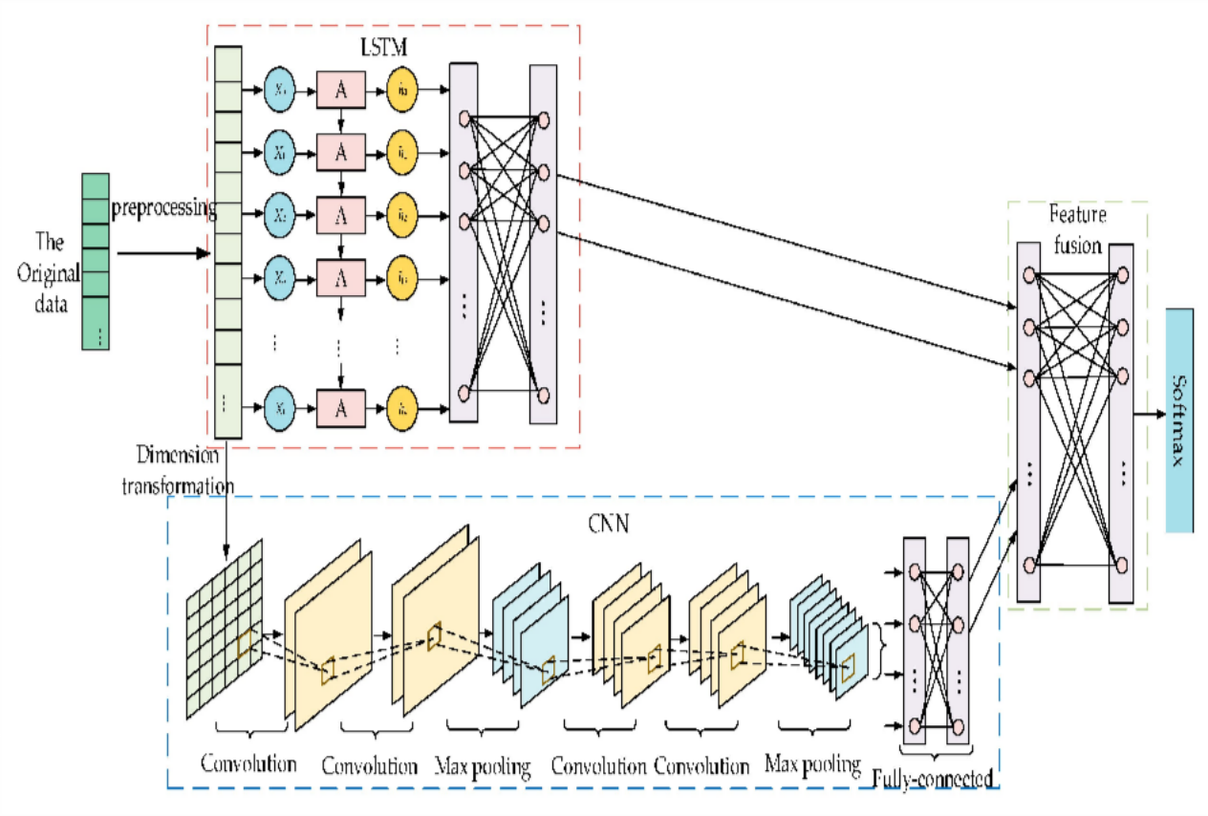
Functional Architecture

Slide 7
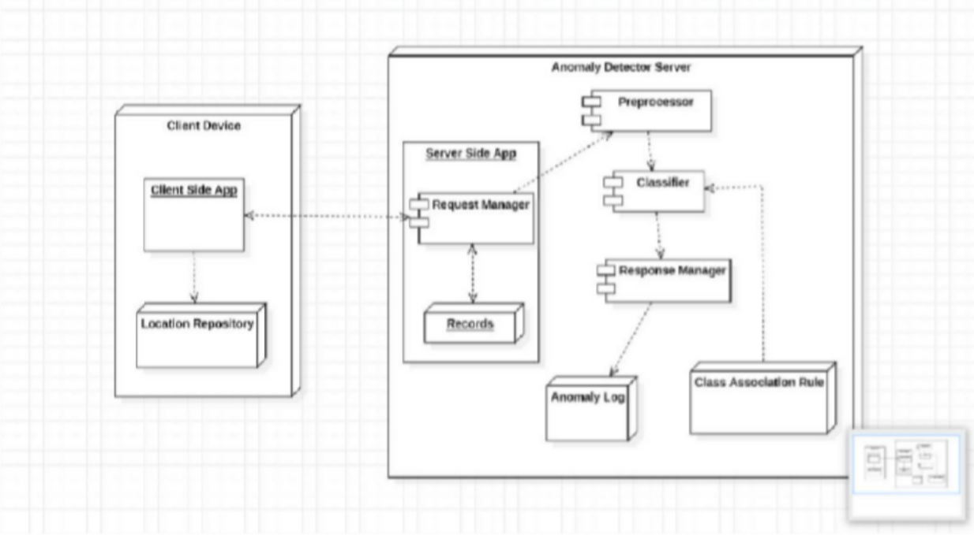
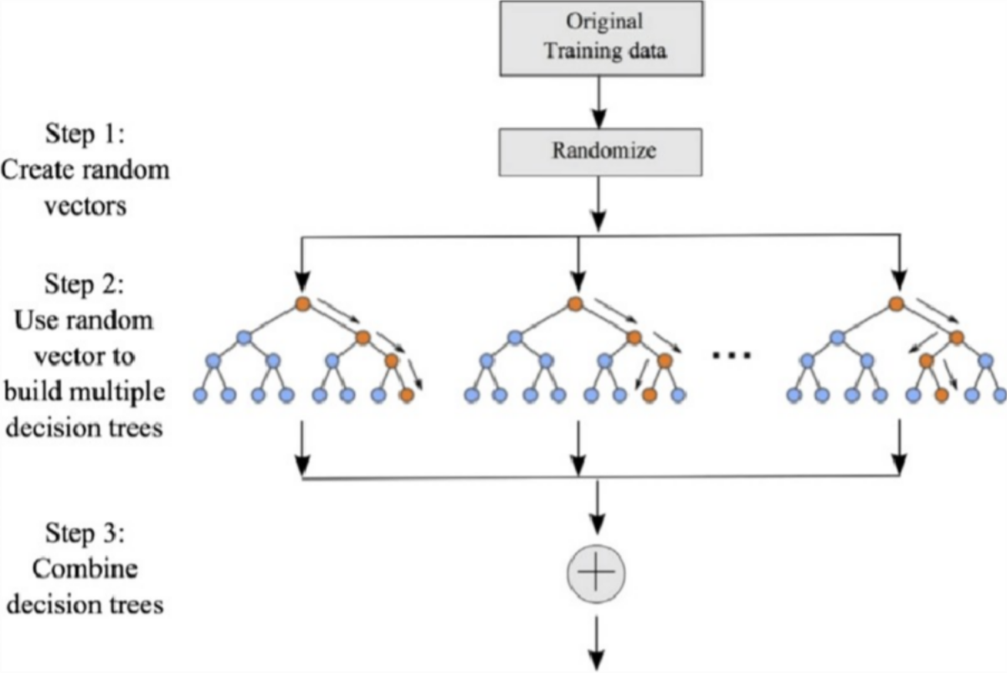

Slide 8
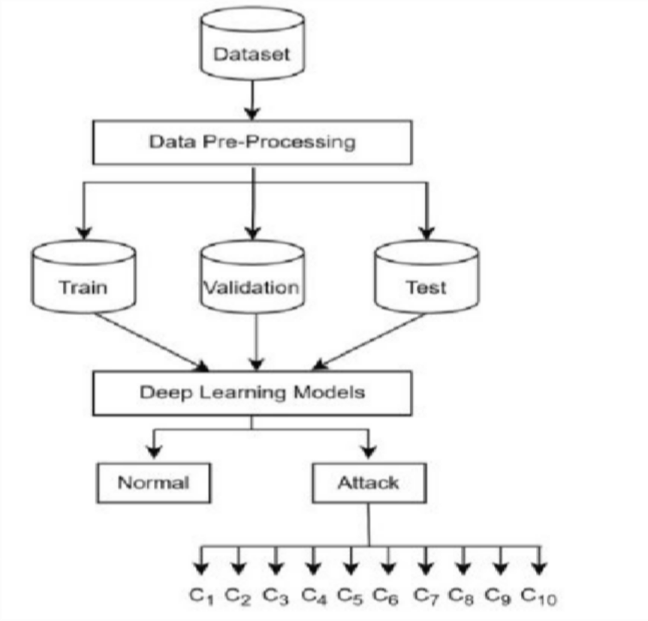
Preprocessing
Data Preprocessing: Preprocess the collected data by cleaning, transforming, and normalizing it as necessary. Ensure that the data is in a suitable format for training the machine learning model.Load the network traffic dataset, ensuring it's properly formatted.Handle missing values, categorical features, and feature scaling if necessary.Split the dataset into training and testing sets.
Data Collection: Gather network traffic data, system information, and process data from various sources, ensuring the dataset is representative of diverse network environments and potential intrusion scenarios.
Data Cleaning: Remove any duplicate or irrelevant entries from the dataset to ensure data quality. Handle missing values appropriately by imputing them or removing them based on the nature of the data.
Data Splitting: Divide the dataset into training and testing sets to facilitate model training, hyperparameter tuning, and performance evaluation. Ensure that each set maintains the same class distribution to prevent bias.
Normalization/Standardization: Scale the features to a common range to prevent certain features from dominating others during model training. This step is particularly crucial for algorithms like Random Forest, which are sensitive to feature scales.
Data Encoding: Convert categorical variables into numerical representations using techniques like one-hot encoding or label encoding, ensuring compatibility with the Random Forest algorithm.

Slide 9
Convolutional Neural Networks (CNN): Input Layer: Takes in the raw input data.
Convolutional Layer: Extracts features from the data using multiple convolution kernels, each with weights and biases. The ReLU activation function is applied for non-linearity.
Pooling Layer: Down samples the data through max pooling, retaining critical information while reducing complexity.
Fully Connected (FC) Layer: Acts as a "classifier," weighting features from previous layers and remapping them to a sample-marker space. Dropout is employed to prevent overfitting.
Output Layer: Produces the final classification output. Convolutional Layer Operation Equation : 𝑋𝑖=𝑓(𝑤𝑖⊗𝑋𝑖−1+𝑏𝑖),
Xi represents the output result of convolution kernel i represents the convolution operation.
f(x) represents the activation function (ReLU - Rectified linear unit is used). Explanation: Convolutional layer extracts characteristic information by sweeping the input data. ReLU activation function prevents gradient disappearance and speeds up model training.
Pooling Layer Operation
Objective: Describe the purpose of the pooling layer in the CNN. Equation : 𝑄𝑗=𝑀𝑎𝑥(𝑃0𝑗,𝑃1𝑗,𝑃2𝑗,𝑃3𝑗…𝑃𝑡𝑗) Qj represents the output result of the pooling region j. Max pooling operation is used.
Explanation:Pooling layer achieves invariance and reduces complexity by down sampling. Max pooling retains critical information for better performance.

Slide 10
Fully Connected (FC) Layer Objective: Explain the role of FC layers in the CNN.
Operation:FC layers act as "classifiers" in the entire CNN.
Dropout operation is implemented to prevent overfitting.
Significance: Weights features of convolutional and pooling layers, remapping them to the sample-marker space.
Long Short-Term Memory Networks (LSTM) Components:
Key Components:
Forget gate: Determines how much information is forgotten. Input gate: Manages the update status of information.
Output gate: Determines the final output based on the current cell state. Functionality:
LSTM solves the issues of gradient explosion or disappearance in traditional RNNs. Long-term memory and short-term memory are activated through gate structures.
Feature Fusion Component Structure:
Full connections between layers with activation functions for nonlinearity. MLP composed of an input layer, hidden layers, and an output layer.
Operation:Features extracted by CNN and LSTM are combined into comprehensive features through flattening and contact operations.MLP performs nonlinear mapping, and the output layer predicts classification results. Backpropagation and Parameter Updating: Soft-max classification model is used for identifying intrusion behaviors.

Slide 11
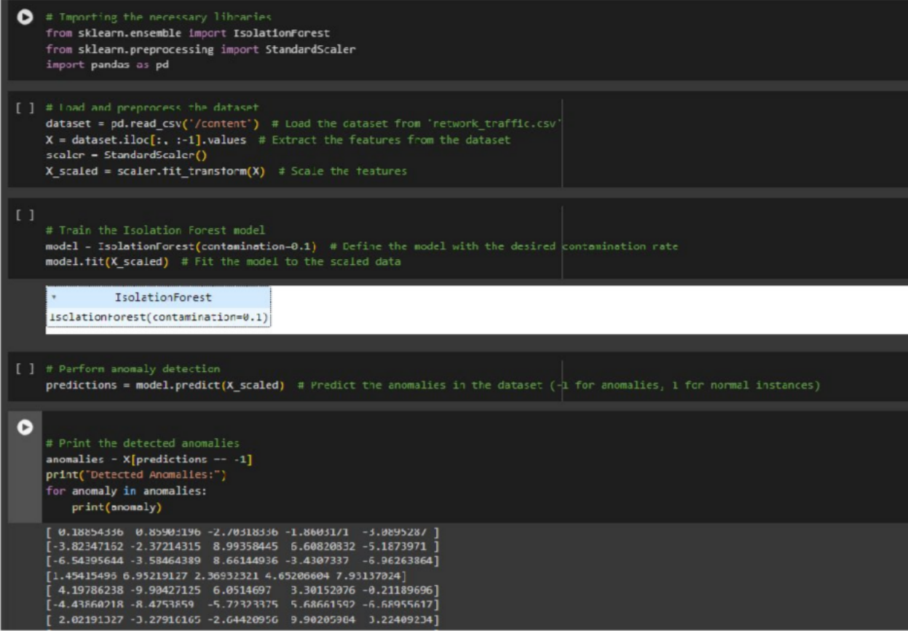
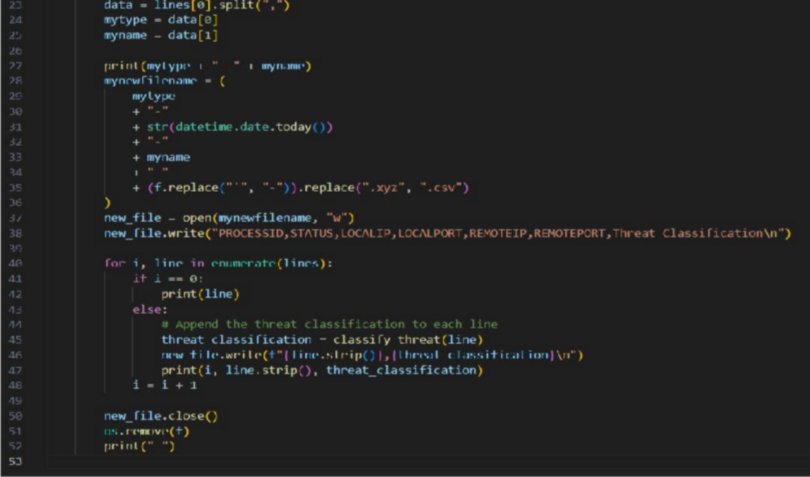
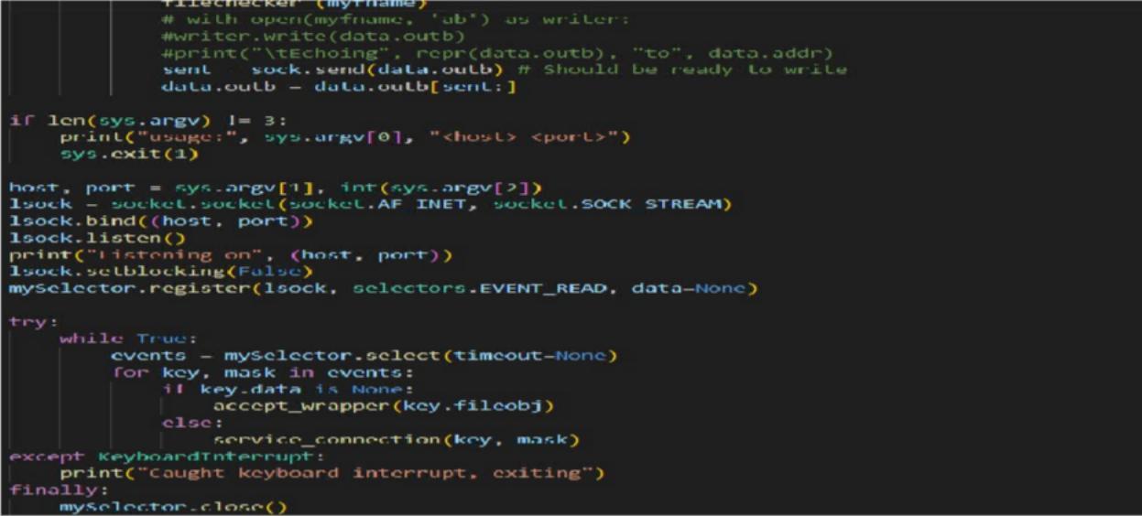
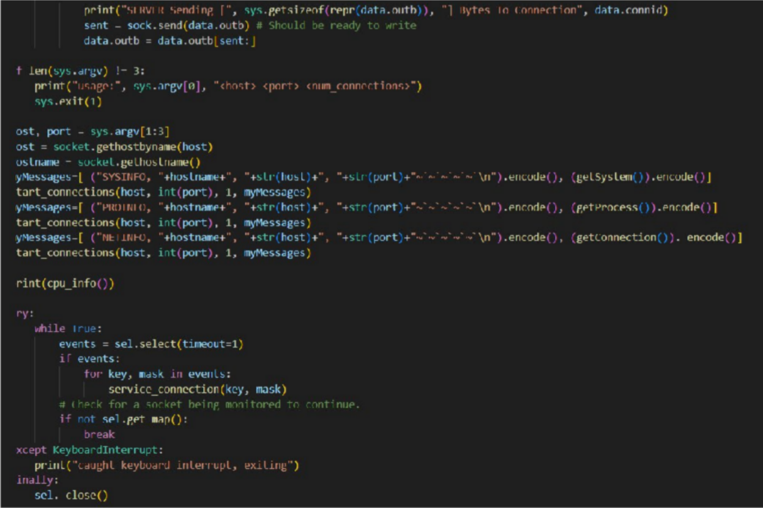
Result Snapshot

Slide 12
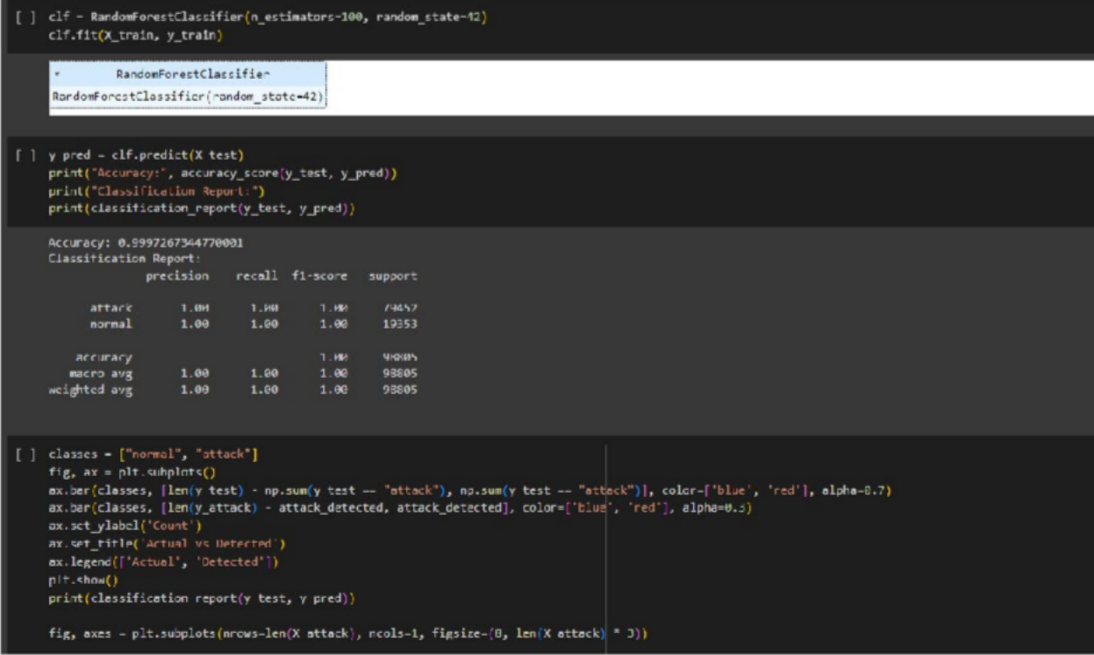
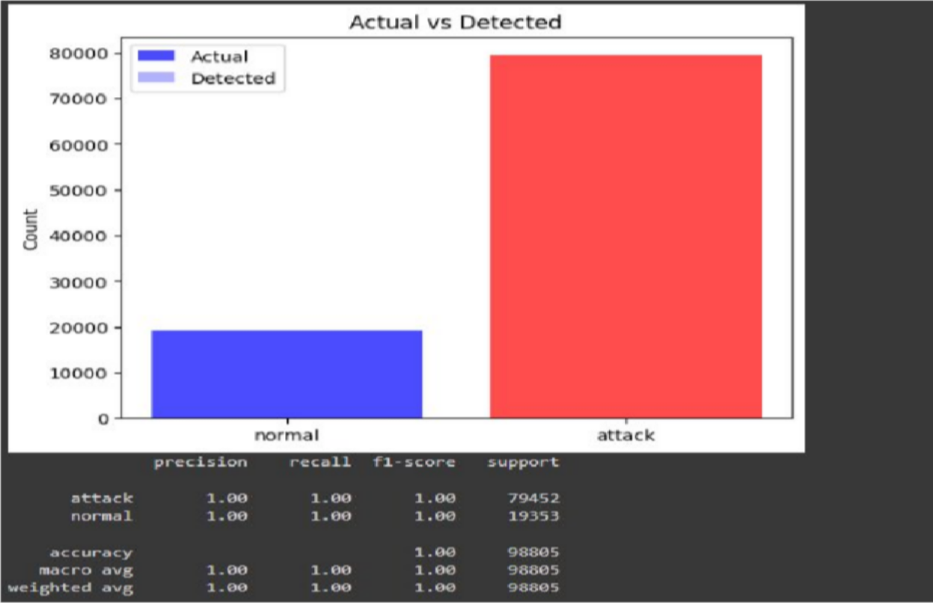
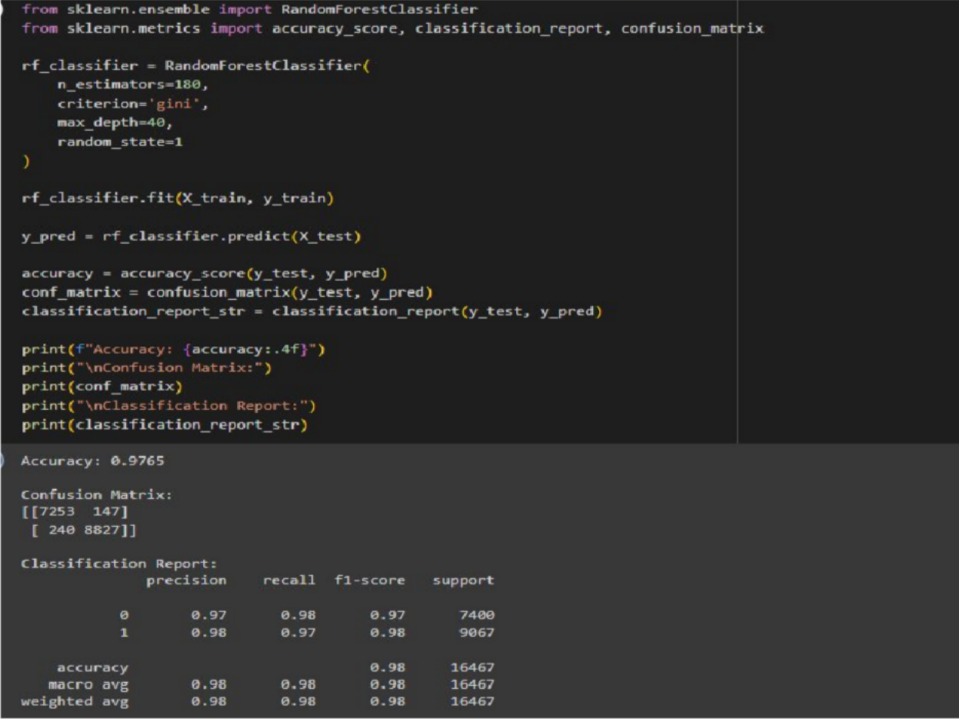
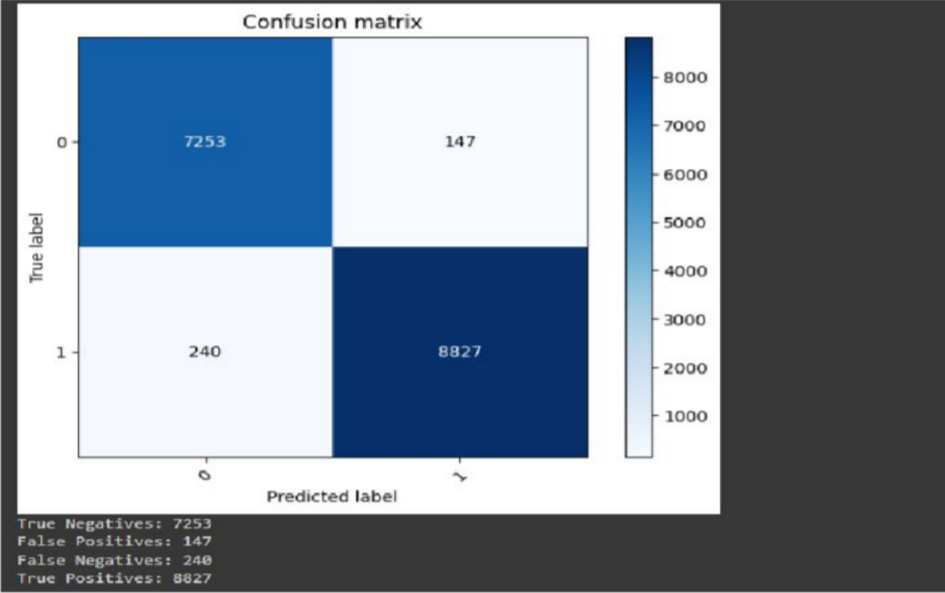

Slide 13
Conclusion and Future Enhancement
Overall, the implemented NIDS stands as a formidable defence mechanism against network intrusions, capable of adapting to evolving cybersecurity threats and safeguarding critical assets. Continuous monitoring, optimisation, and knowledge sharing within the cybersecurity community will further enhance the NIDS capabilities and contribute to the advancement of network intrusion detection techniques in combating cyber threats.
References
M. Landauer, et al.,"Maintainable Log Datasets for Evaluation of Intrusion Detection Systems" in IEEE Transactions on Dependable and Secure Computing, vol. 20, no. 04, pp. 3466-3482, 2023. doi: 10.1109/TDSC.2022.3201582 keywords: {behavioral sciences;intrusion detection;security;data models;computational modeling;labeling;analytical models}
Abaimov, Stanislav. (2021). Towards a Privacy-preserving Deep Learning-based Network Intrusion Detection in Data Distribution Services.
Khan, Ahsan Al Zaki & Serpen, Gursel. (2020). Intrusion Detection and identification System Design and Performance Evaluation for Industrial SCADA Networks.
Ö. Sen, P. Malskorn, S. Glomb, I. Hacker, M. Henze and A. Ulbig, "An Approach to Abstract Multi-stage Cyberattack Data Generation for ML-Based IDS in Smart Grids," 2023 IEEE Belgrade PowerTech, Belgrade, Serbia, 2023, pp. 01-10, doi: 10.1109/PowerTech55446.2023.10202747. keywords: {Training;Laboratories;Training data;Intrusion detection;Machine learning;Data models;Smart grids;Intrusion Detection;Smart Grid;Cyberattacks;Machine Learning;Knowledge Graphs},
S. A. Varghese, A. Dehlaghi Ghadim, A. Balador, Z. Alimadadi and P. Papadimitratos, "Digital Twin-based Intrusion Detection for Industrial Control Systems," 2022 IEEE International Conference on Pervasive Computing and Communications Workshops and other Affiliated Events (PerCom Workshops), Pisa, Italy, 2022, pp. 611-617, doi: 10.1109/PerComWorkshops53856.2022.9767492. keywords: {Machine learning algorithms;Industrial control;Digital twin;Conferences;Intrusion detection;Predictive models;Real-time systems;Digital Twin;Intrusion Detection Systems;Industrial Control Systems;Machine Learning;Stacked Ensemble Model},

